Slide 1


Semester: I/II
CHEMISTRY OF SMART MATERIALS AND DEVICES (Category: Professional Core Course) Stream: CS (Theory and Practice)
Course Code | : | 22CHY12A |  | CIE | : | 100+50 Marks
Credits: L:T:P | : | 3:0:1 |  | SEE | : | 100 Marks
Total Hours | : | 42L+ 30P |  | SEE Duration | : | 3 Hours
S. Girish Kumar
Assistant Professor, Department of Chemistry, RV College of Engineering
Bengaluru-560059, INDIA, Phone: +91 9844772416
E-mail: girishkumars@rvce.edu.in; girichem@yahoo.co.in

Slide 2
UNIT-I: Sustainable chemistry and E-waste management:
Biomaterials: Introduction, bio-degradable and bio-compatible polymeric materials: synthesis and applications (Polymers and hydrogels in drug delivery).
Green Chemistry: Introduction, 12 principles with real life examples, validation of greenness.
E-waste: Hazards and toxicity, segregation and recycling (Hydrometallurgy, pyrometallurgy and direct recycling). Extraction of valuable metals from E-waste. Battery waste management and recycling, circular economy- case studies.

Slide 3
POLYMERS
Polymerization
Nature of carbon chain backbone
Addition polymers
Condensation polymers
Based on molecular forces
Degradable and
Non-degradable
Thermosetting polymers,
Thermoplastic polymers
Polar functional groups – degrades
Non-polar functional groups – difficult to degrade

Slide 4
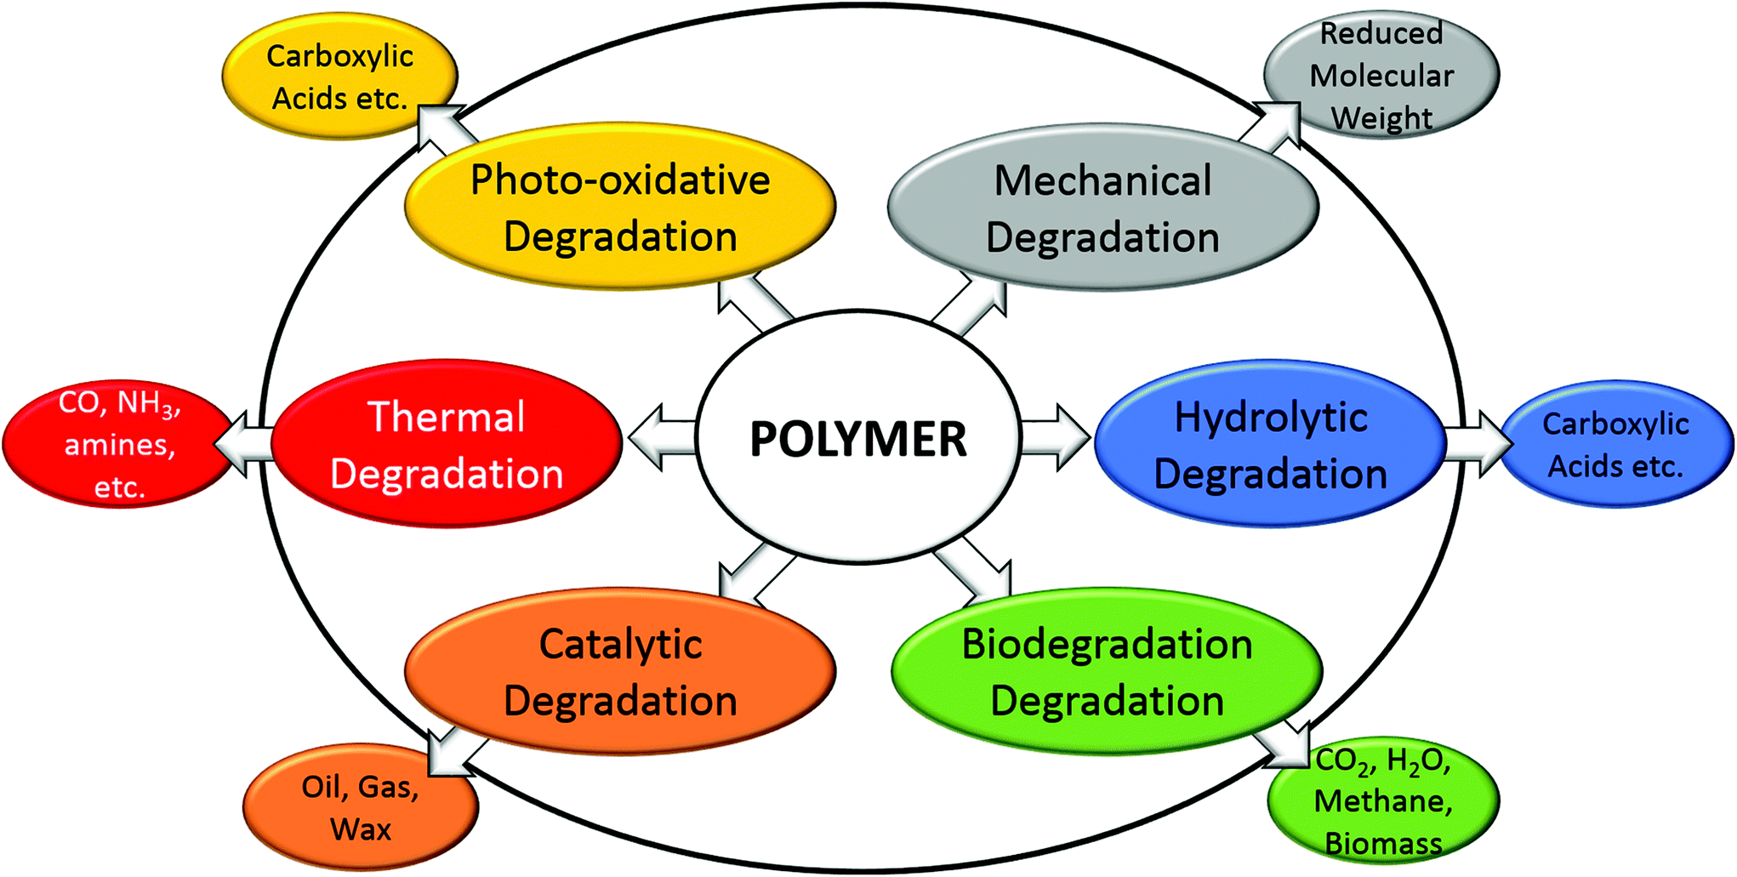
Degradation

Slide 5
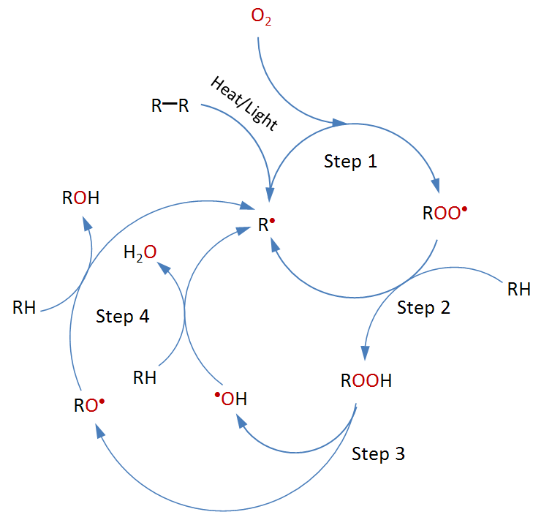
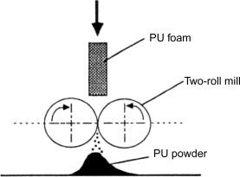
Mechanical Degradation
Degradation through heat/light

Slide 6
Biodegradation
Initiated by enzymes – hydrolase (phosphatases, esterases, protease
Polymers breaks down to monomers, dimers and oligomers
Initiated by acids/peroxides
Enzymes are specific to attack various bonding sites
-C-C- bonds : Oxaloacetase
-C-O- bonds : Esterase
-C-N- bonds: Asparaginase
-P-N- bonds: Phosphoamidase

Slide 7
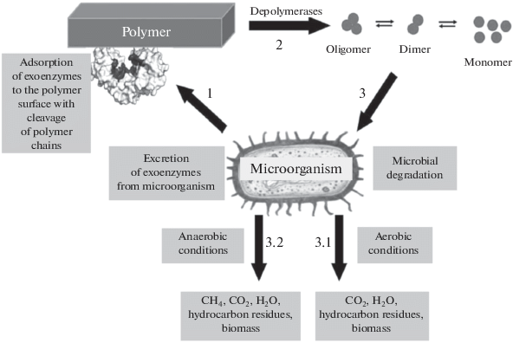
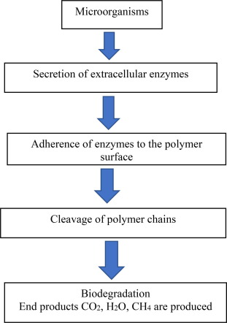
Mechanism of degradation:

Slide 8
Requirements for degradation
Rate of degradation should be always greater than rate of accumulation
Intermediate products should be less toxic
End products – mineral acids, CO₂ and biomass
Duration – Must be short (week or months) and not years from the prospect of cost-effectiveness.
Factors influencing the degradation
Environmental factors: Humidity and Temperature,
Polymers: Molar masses, crystallinity, porosity, extent of cross-linking

Slide 9
Biodegradable polymers: Polymers which degrade quickly in aqueous medium in the presence of microorganisms, and their byproducts are eco-friendly (biocompatible) such as CO₂, water, methane, and inorganic compounds or biomass that is easily scavenged by microorganisms.
These polymers are degraded by simple hydrolysis - in turn prevents inflammatory reactions.
The hydrolytic products from such degradation process are then transformed into non toxic byproducts that are eliminated through normal cellular activity.
Poly-lactic acid (PLA) is one of the most promising biopolymers produced from non toxic renewable and naturally occurring organic acid- lactic acid.
It is thermoplastic with good mechanical property profile, high biocompatibility and biodegradability properties.
Lactic acid can be produced by fermentation of sugars obtained from renewable resources such as sugarcane.
Therefore, PLA can be produced and used in an environmentally friendly cycle.

Slide 10

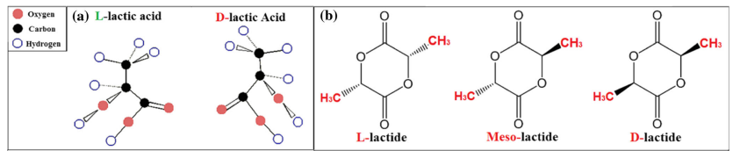
Poly lactic acid (thermoplastic), prepared by different polymerization process from lactic acid including: polycondensation, ring opening polymerization and by direct methods like azeotropic dehydration and enzymatic polymerization.
(a) The stereoisomers of LA. (b) Chemical structures of dimeric D-lactide, L-lactide, and meso-lactide
DOI 10.1007/s10965-017-1227-2

Slide 11
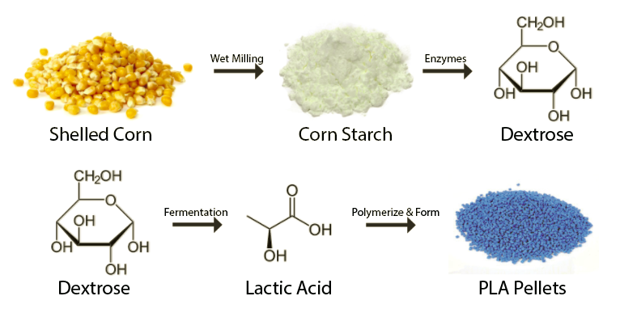
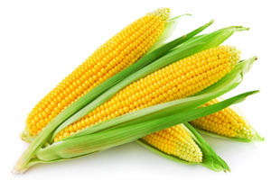
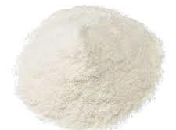
Lactobacillus amylophilus

Slide 12
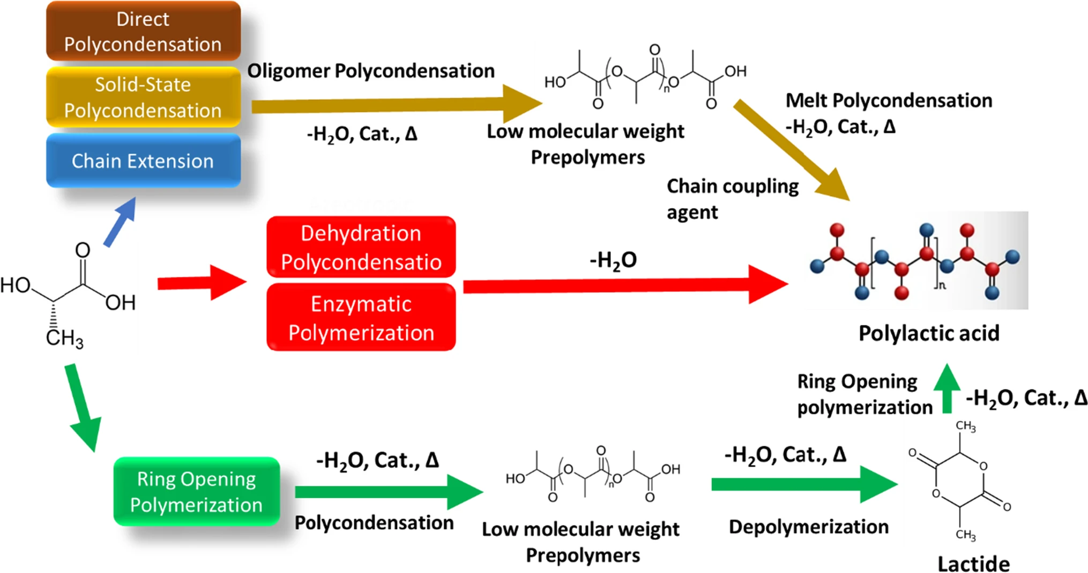
LACTIC ACID TO POLYLACTIC ACID (PLA) PREPARATION
Bis trichloromethyl carbonate
M. Savioli Lopes, School of Chemical Engineering, State University of Campinas, Brazil
doi: 10.1016/j.proeng.2012.07.534

Slide 13
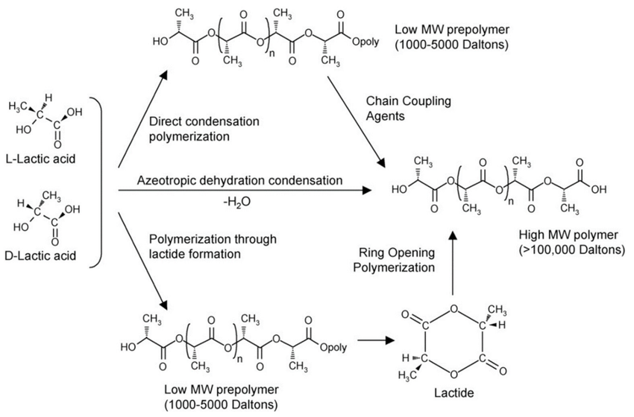
* PLA is linear polymer
Moderate melting point (~433-453 K)
Crystalline in nature
It can be processed into fibers
Soluble in non polar solvents
Chiral in nature

Slide 14

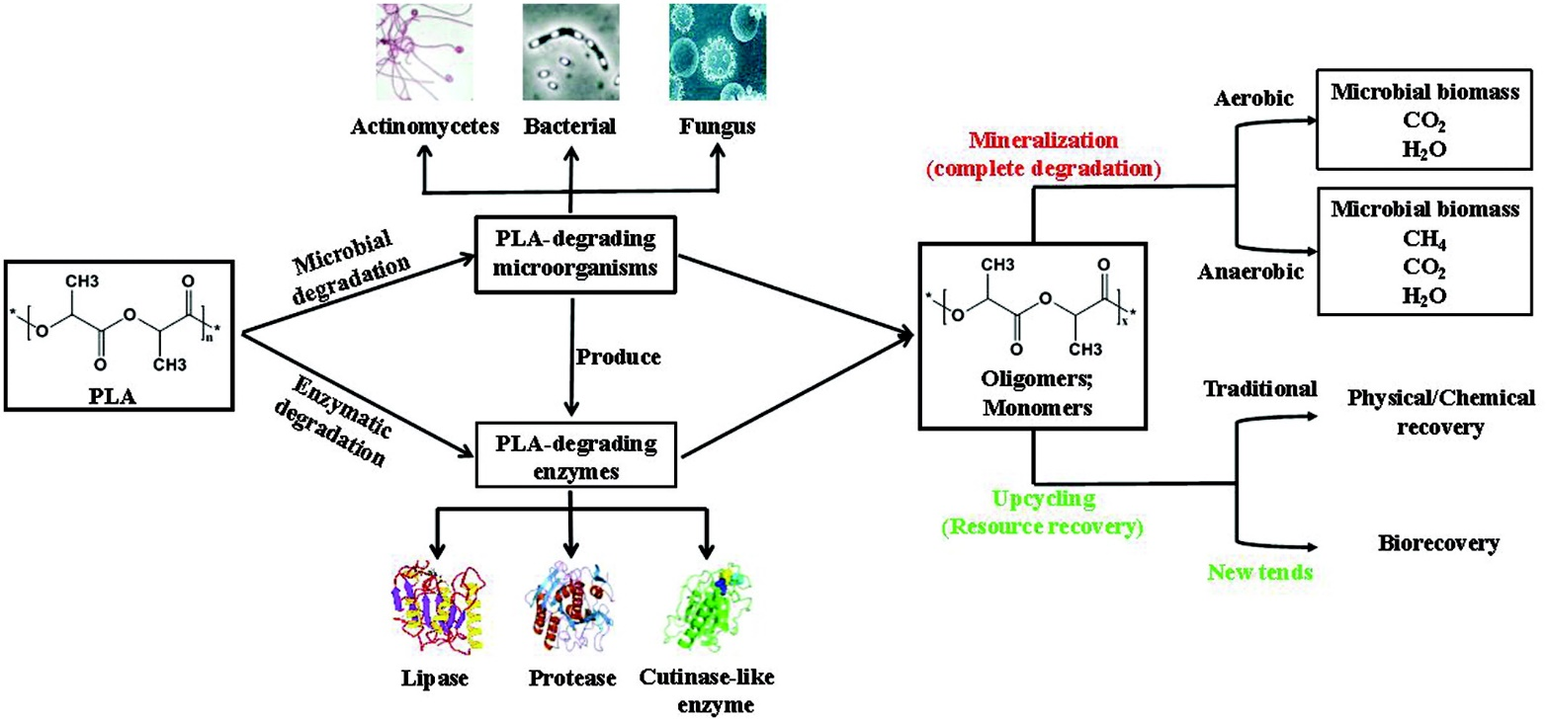
Mechanism of degradation/recovery:
https://doi.org/10.1139/er-2020-0117

Slide 15
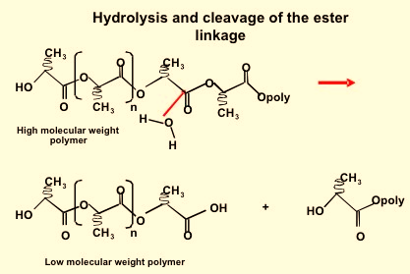
Mechanism of degradation:

Slide 16
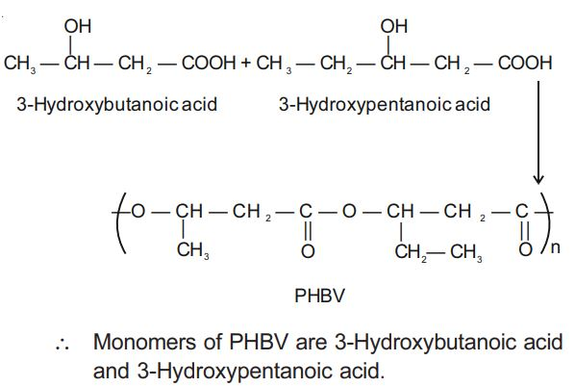
Poly(hydroxybutyrate-co-valerate)(PHBV)
is a completely biodegradable thermoplastic polyester produced by microbial fermentation, which has an excellent biocompatible and biodegradable properties

Slide 17
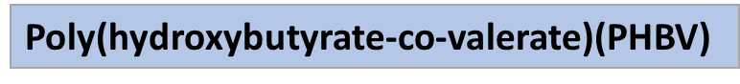
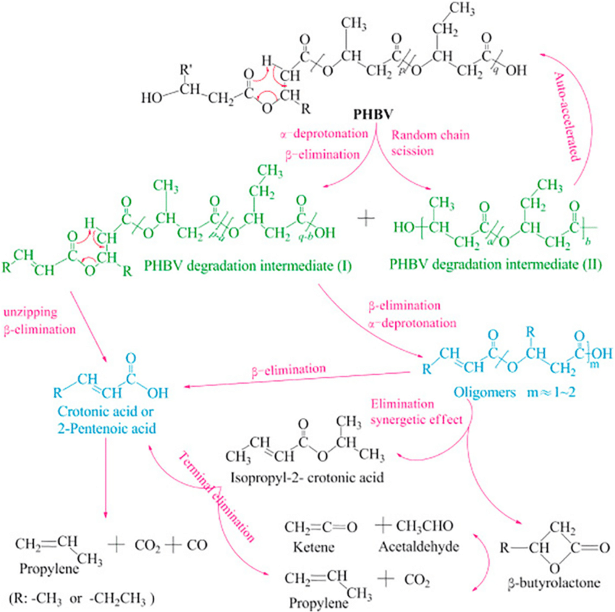

Slide 18


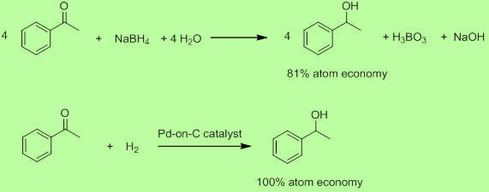
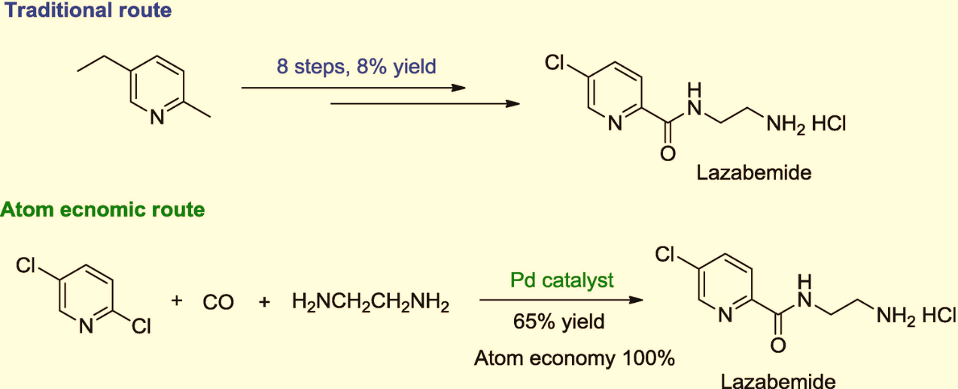
GC2. ATOM ECONOMY
Synthetic methods should be designed to maximize incorporation of all materials used in the process into the final product

Slide 19
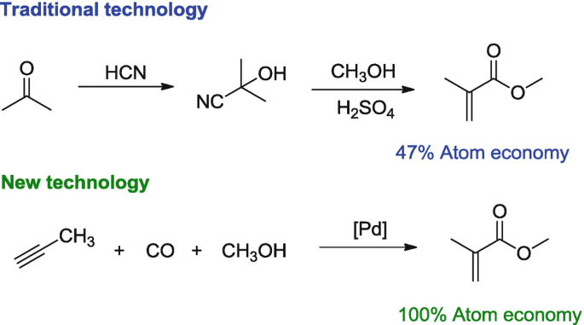
GC2. ATOM ECONOMY
Synthetic methods should be designed to maximize incorporation of all materials used in the process into the final product

Slide 20
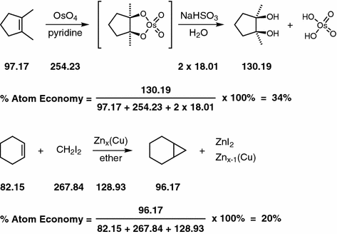
GC2. ATOM ECONOMY

Slide 21
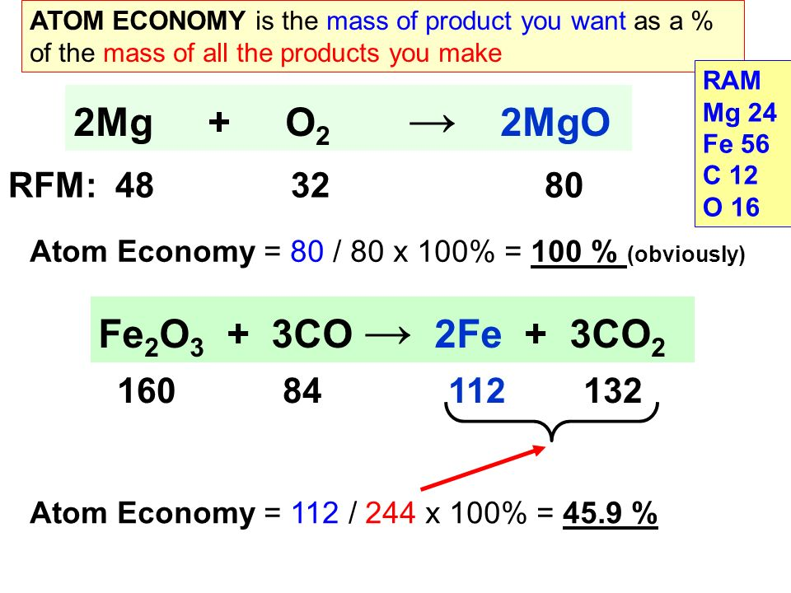
GC2. ATOM ECONOMY

Slide 22
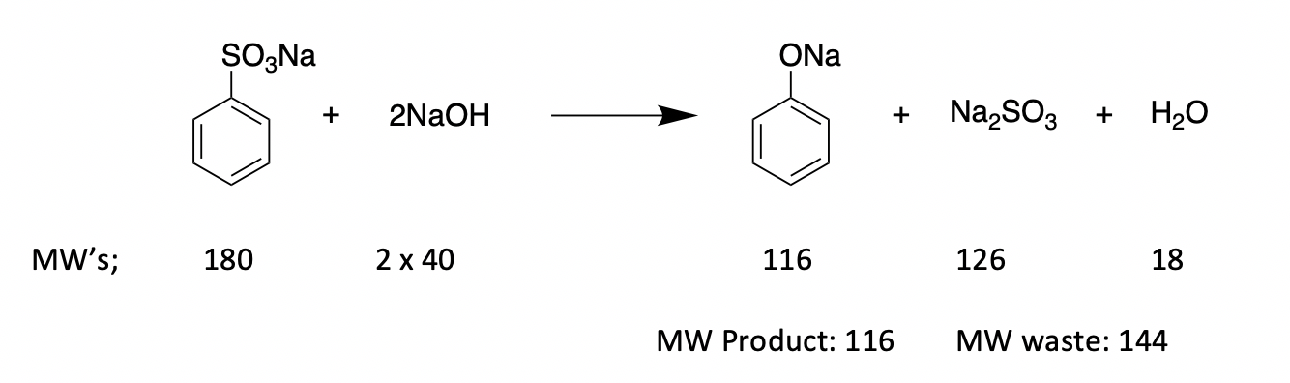
GC2. ATOM ECONOMY

Slide 23
Biocompatible polymeric materials:
Biocompatible – materials (polymers, metals, ceramics) that functions with the living cells and do not produce any deleterious effects when administered into the human body.
They are intended to interface with biological systems to treat or replace any tissues/organs of the body.
Applications: Vaccinate the wild animals – bio bullets
https://doi.org/10.1021/acsbiomaterials.1c00757

Slide 24
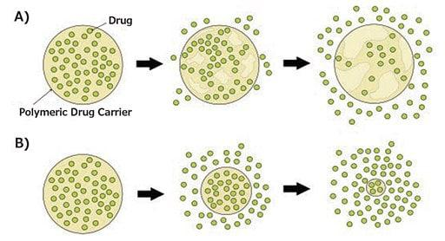
Polymers has to be porous in nature to allow the diffusion process
Water permeation into the polymer is greater than polymer degradation
- BULK EROSION
Rate of polymer degradation is higher than rater of water permeation
- SURFACE EROSION
Degradation mechanisms of biodegradable polymeric drug carriers:
A) bulk erosion, B) surface erosion.
https://doi.org/10.1021/acsbiomaterials.1c00757

Slide 25
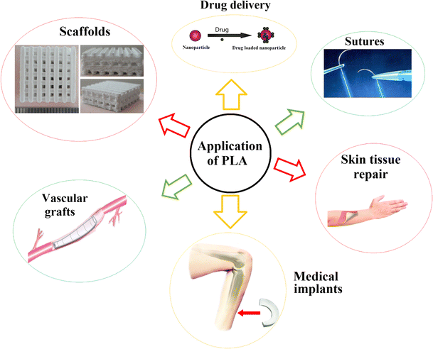
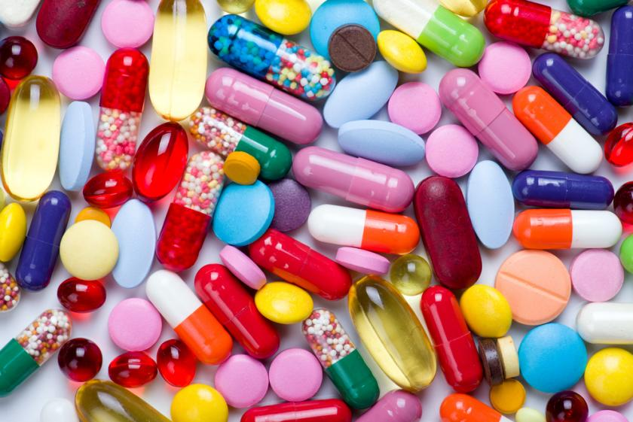
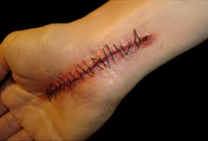
https://doi.org/10.1007/s10965-017-1227-2
Journal of Applied Microbiology, Volume: 127, Issue: 6, Pages: 1612-1626, First published: 25 April 2019, DOI: (10.1111/jam.14290)

Slide 26
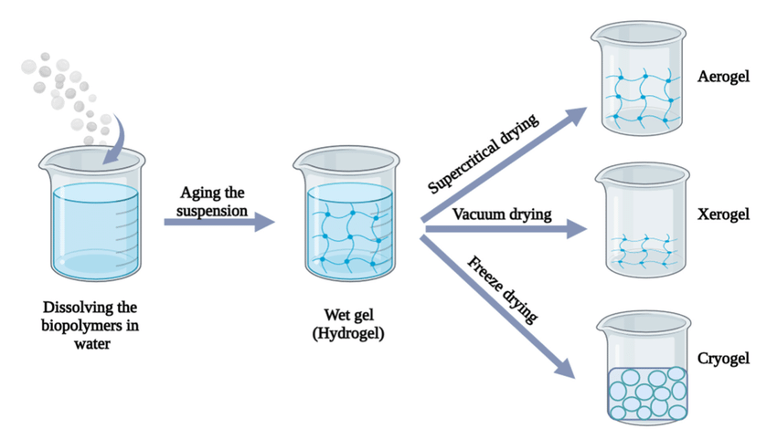
Organic gels
Alcogel
Liquid component in the gel is
replaced by AIR
Solid formed by drying the gel –
Shrink materials
Solvents are frozen under ice cold
conditions followed by their removal
Ultra low conductivity ; Ultra light weight material
Tunable density and refractive index; High specific surface area

Slide 27
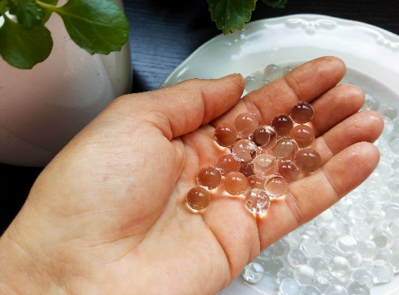
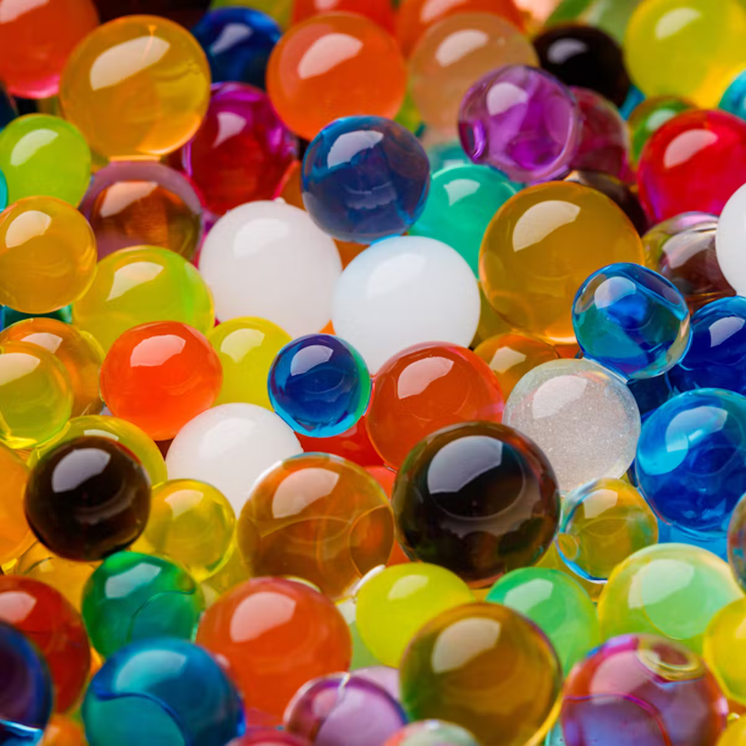
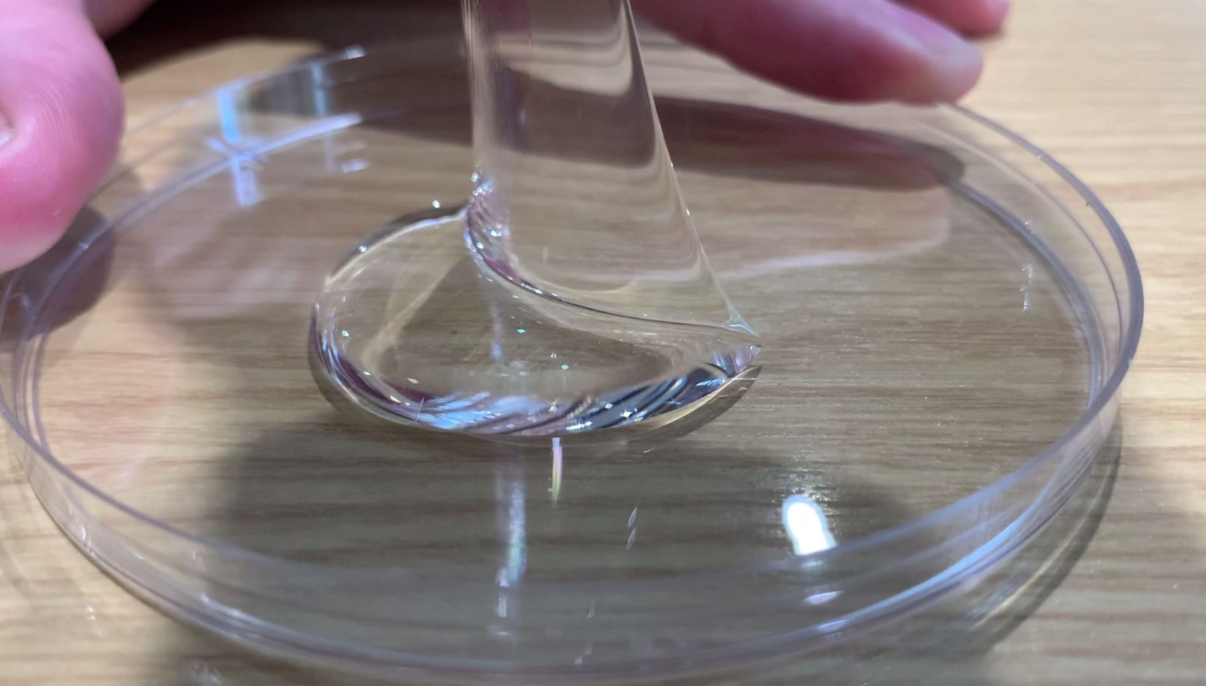
Hydrogels: It is a three-dimensional (3D) network of hydrophilic polymers that are capable of holding the large amount of water in their 3D network. These 3D network can retain the original structure through chemical or physical cross-linking of individual polymer chains.
The ability of hydrogels to absorb water arises from hydrophilic functional groups attached to the polymeric backbone, while their resistance to dissolution arises from cross-links between network chains.
The hydrophilicity of the network is due to the presence of hydrophilic groups such as -NH₂, -COOH, -OH, -CONH₂, - CONH -, and -SO₃H.

Slide 28
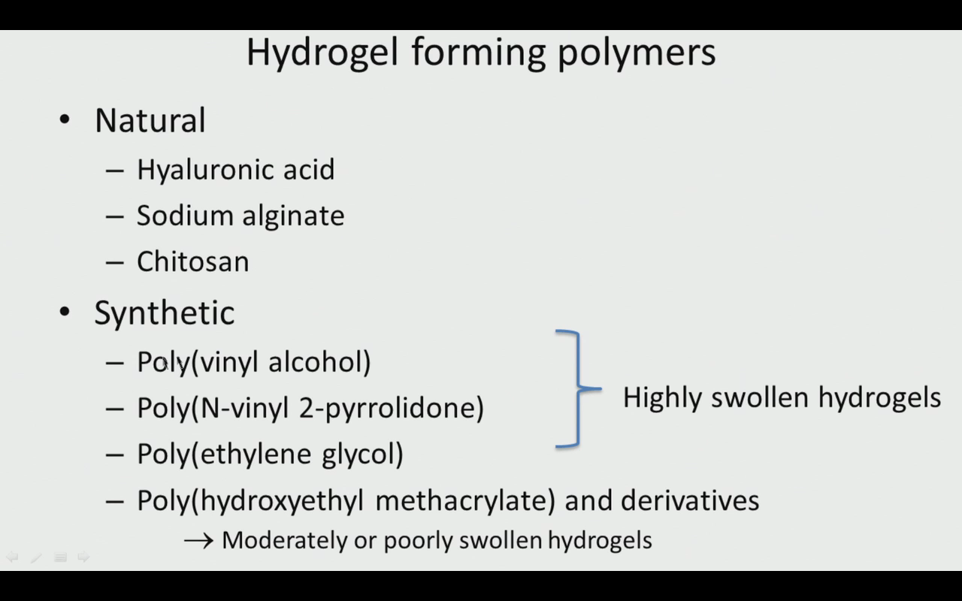

Slide 29
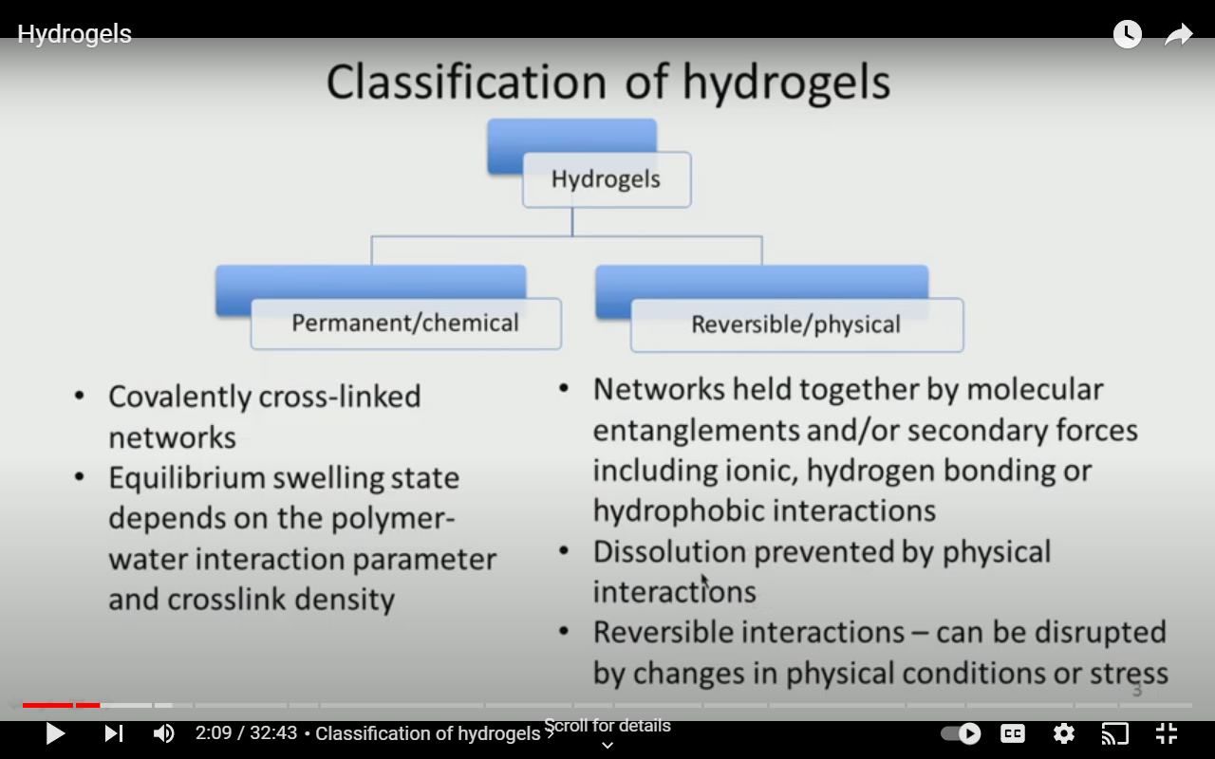

Slide 30
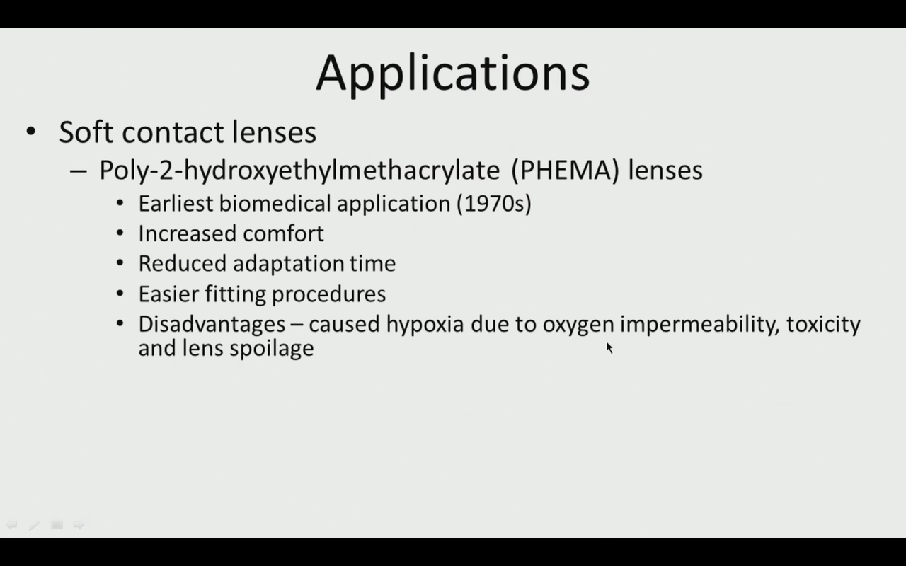

Slide 31
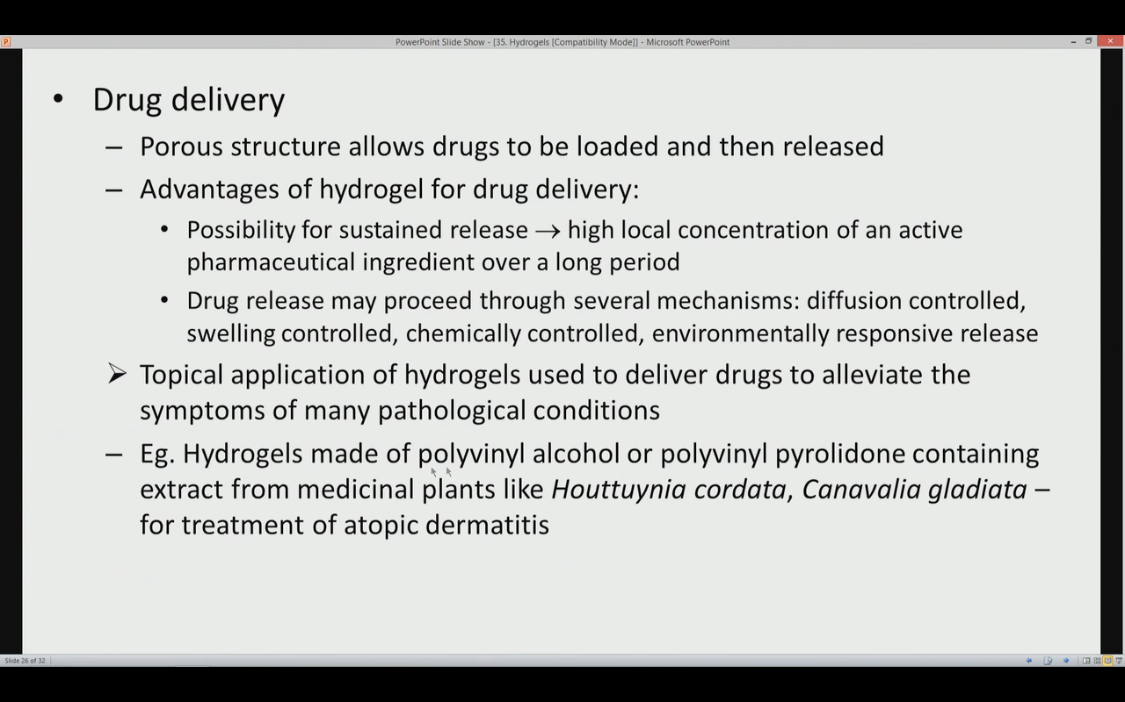

Slide 32
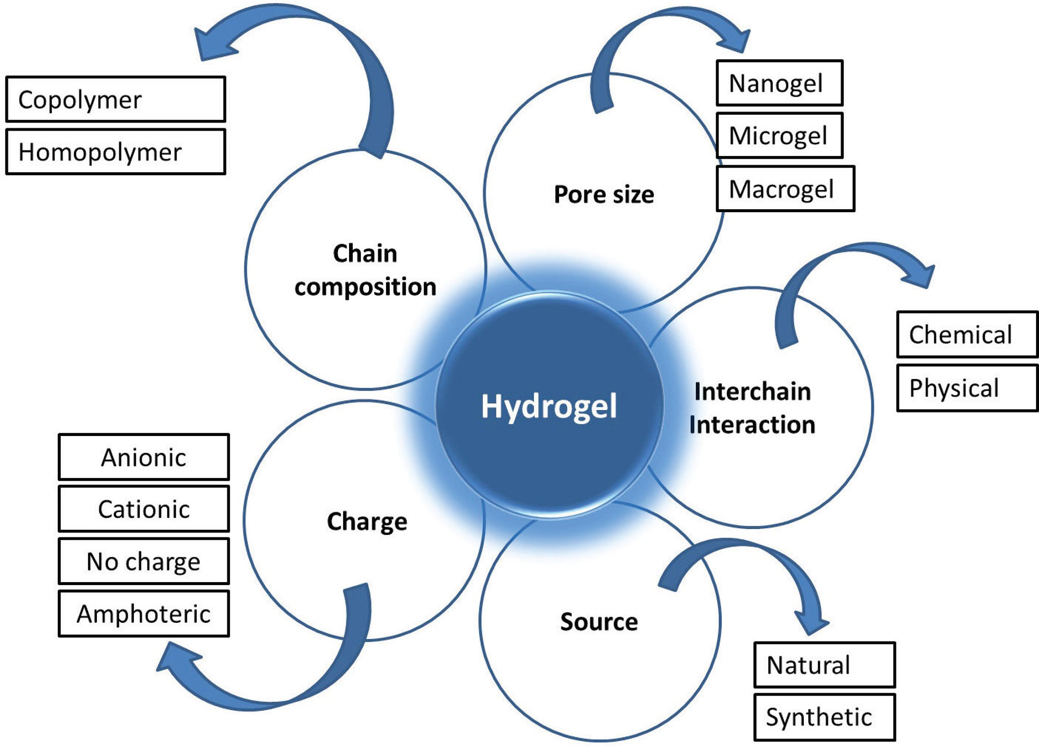

Slide 33
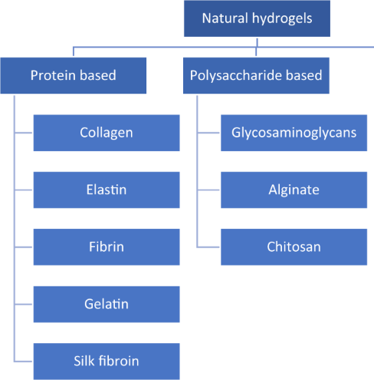
https://doi.org/10.1007/s10856-019-6318-7

Slide 34
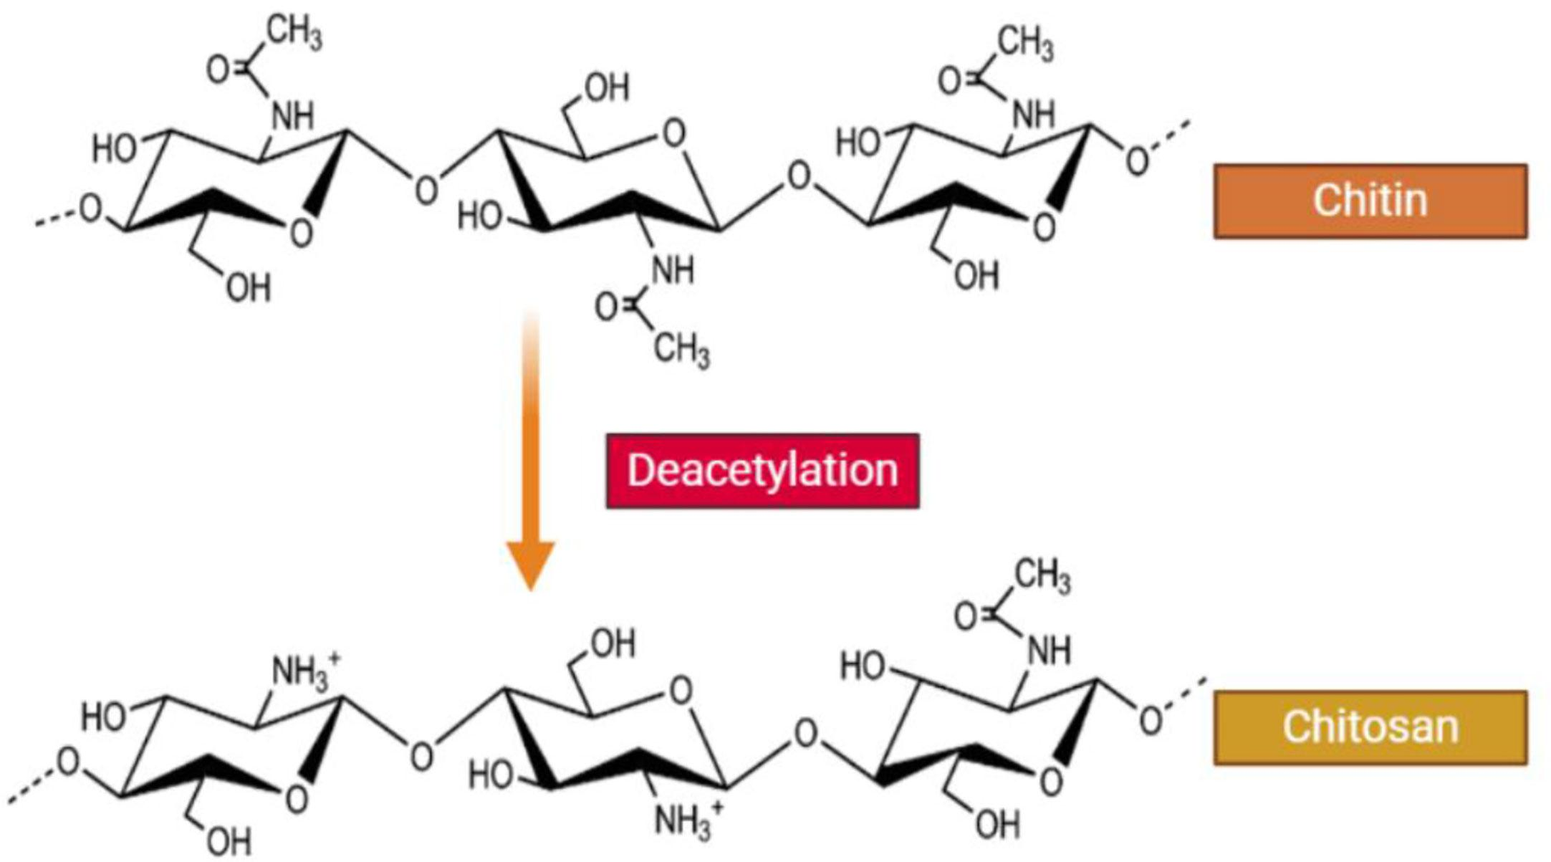
Structure of chitin and chitosan
Chitosan (CH) is a modified biopolymer obtained via partial de-acetylation of the naturally occurring polysaccharide called chitin, which contains randomly distributed (1→ 4)-linked N-acetyl glucosamine and glucosamine units
https://doi.org/10.3389/fcimb.2021.643953

Slide 35
CH has advantages such as
biodegradability
hydrophilicity
biocompatibility
Bioactivity
obtained from renewable and natural sources.
It can be processed into distinct forms
solutions
blends
sponges
membrane
gels
paste
tablets

Slide 36
Due to their superior biocompatibility and low toxicity, hydrogels play a significant role in the biomedical fields
Examples:
Chitosan, a Natural Polymer : N, O-carboxymethyl chitosan incorporated fayalite (Fe2SiO4), which could release bioactive ions with mild heating function to in wound area to enhance angiogenesis and chronic wound healing.
PVA, a synthetic hydrophilic polyhydroxyl polymer, PVA has been largely employed in tissues such as the bone, heart, nerve, and vascular network

Slide 37


Slide 38
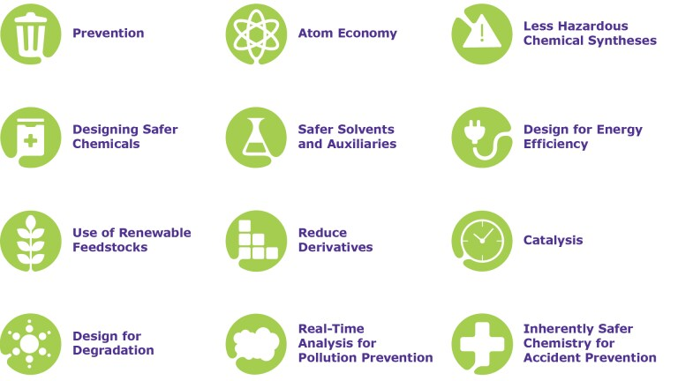
Green Chemistry
Green chemistry is the design of chemical products and processes that reduce or eliminate the use or generation of hazardous substances.
https://www.merckgroup.com/content/dam/web/corporate/images/responsibility/global/DOZN_EN.png/_jcr_content/renditions/Mkgaa1920x1080

Slide 39
Green Chemistry: Introduction-Basic principles.
Green chemistry is the design of chemical products and processes that reduce or eliminate the use or generation of hazardous substances.
The twelve principles of green chemistry are:
Prevention: It is better to prevent waste than to treat or clean up waste after it has been created.
Atom economy: Synthetic methods should be designed to maximize incorporation of all materials used in the process into the final product.
Less hazardous chemical syntheses: Wherever practicable, synthetic methods should be designed to use and generate substances that possess little or no toxicity to human health and the environment.
Designing safer chemicals: Chemical products should be designed to preserve efficacy of function while reducing toxicity.
Safer solvents, and auxiliaries: The use of auxiliary substances (e.g., solvents, separation agents, etc.) should be made unnecessary wherever possible and, innocuous when used.
Design for energy efficiency: Energy requirements should be recognized for their environmental and economic impacts and should be minimized. Synthetic methods should be conducted at ambient temperature and pressure

Slide 40
Use of renewable feedstock: A raw material or feedstock should be renewable rather than depleting whenever technically and economically practicable.
Reduce derivatives: Unnecessary derivatization (use of blocking groups, protection/deprotection, temporary modification of physical/chemical processes) should be minimized or avoided if possible, because such steps require additional reagents and can generate waste.
Catalysis: Catalytic reagents (as selective as possible) are superior to stoichiometric reagents.
Design for degradation: Chemical products should be designed so that at the end of their function they break down into harmless degradation products and do not persist in the environment.
Real-time analysis for pollution prevention: Analytical methodologies need to be further developed to allow for real-time, in-process monitoring and control prior to the formation of hazardous substances.
Inherently safer chemistry for accident prevention: Substances and the form of a substance used in a chemical process should be chosen to minimize the potential for chemical accidents, including releases, explosions, and fires.

Slide 41
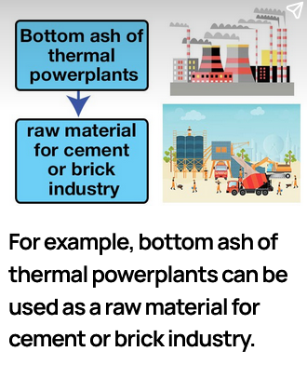
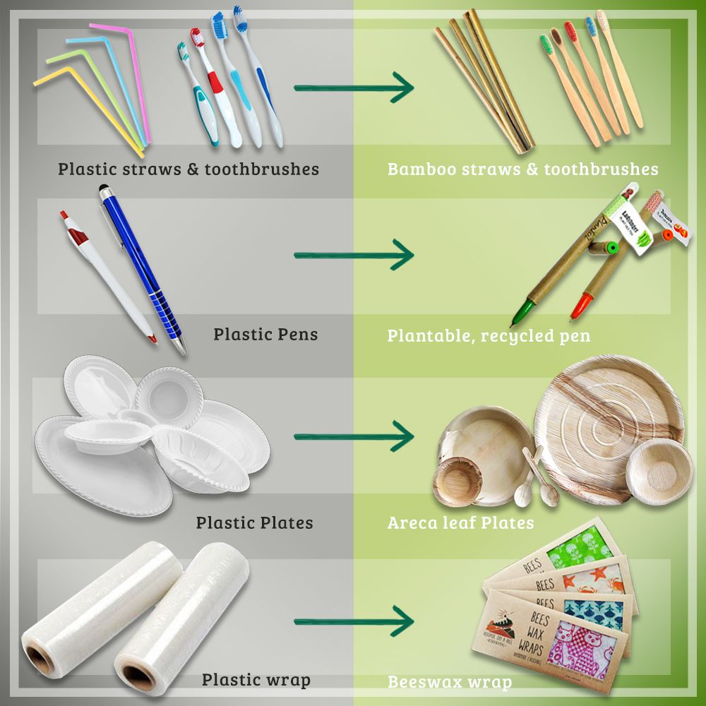
GC1. PREVENTION
It is better to prevent waste than to treat or clean up waste after it has been created.

Slide 42
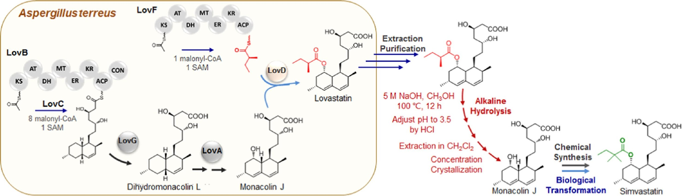
(1) Prevent waste: Designing the reaction that leaves less waste
Classic illustration: Simvastatin drug is synthesized on the industrial scale via three steps:
(i) Microbial production of Lovastatin;
(ii) alkaline Hydrolysis combined with organic extraction to produce Monacolin J;
(iii) chemical/biological step to form simvastatin.

Slide 43
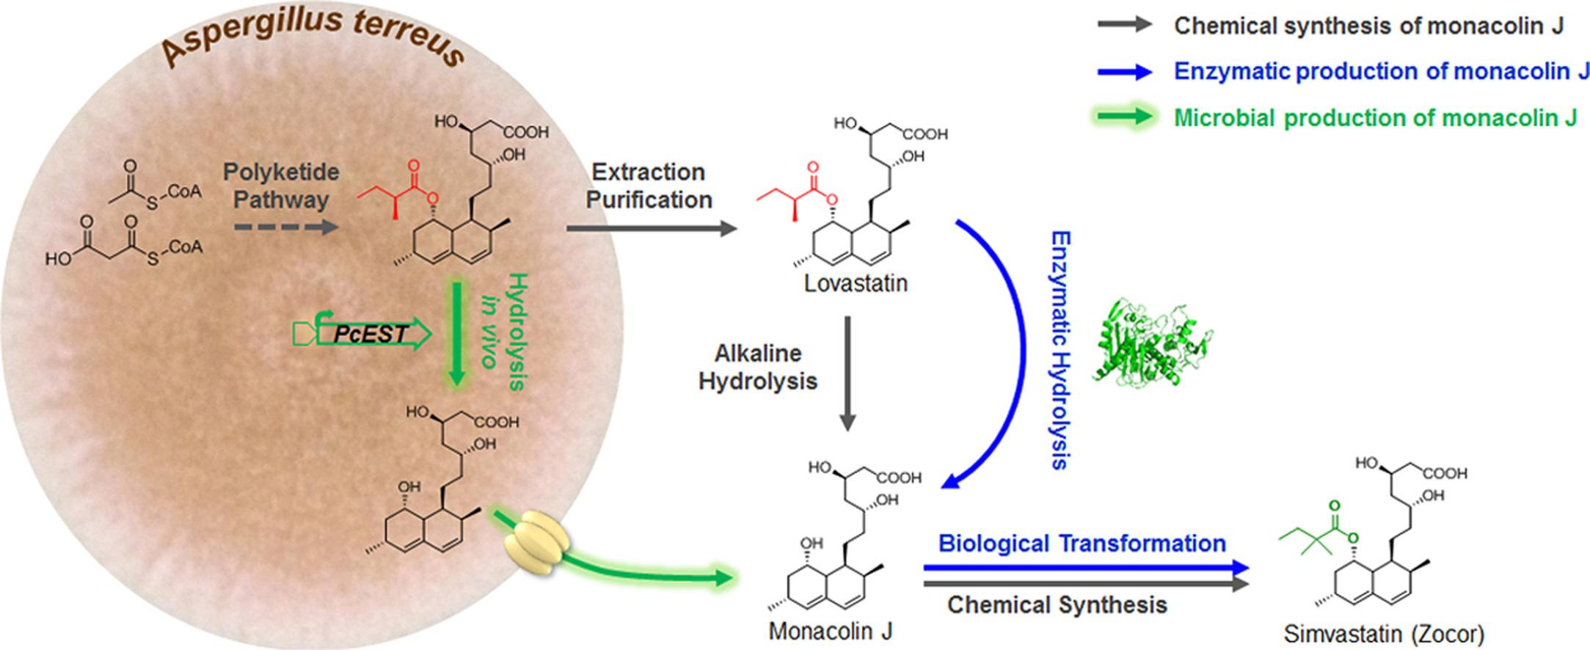
https://doi.org/10.1016/j.ymben.2017.06.005
Huang et al. reported direct transformation of Lovastatin to monacolin J through enzymatic hydrolysis. Thus, use of strong alkaline, organic
Solvents are avoided.
https://doi.org/10.1021/acsbiomaterials.1c00757

Slide 44

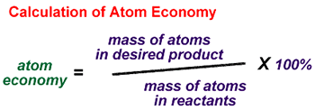
Atom economy: Introduced by Prob. Barry Trost (Stanford University) –
As many as possible incorporation of all raw materials into final products in the process of fine chemical synthesis
through well-designed synthetic method and technology.
https://doi.org/10.1021/acsbiomaterials.1c00757

Slide 45
GC2. ATOM ECONOMY
Synthetic methods should be designed to maximize incorporation of all materials used in the process into the final product

Slide 46
GC2. ATOM ECONOMY
Synthetic methods should be designed to maximize incorporation of all materials used in the process into the final product

Slide 47
GC2. ATOM ECONOMY

Slide 48
GC2. ATOM ECONOMY

Slide 49
GC2. ATOM ECONOMY

Slide 50
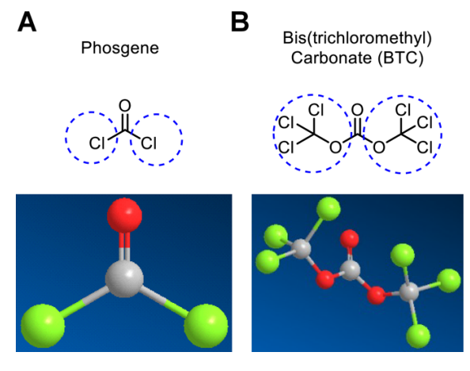
GC3. LESS HAZARDOUS CHEMICAL SYNTHESIS
Wherever practicable, synthetic methods should be designed to use and generate substances that possess little or no toxicity to human health and the environment.
Ex: Phosgene is hazardous, therefore we should replace it with a safer one.
Bis(trichloromethyl)carbonate (BTC, triphosgene) is a versatile compound that enables highly efficient syntheses. In addition, because of its solid state, it is a very convenient compound for small-scale phosgenations.

Slide 51
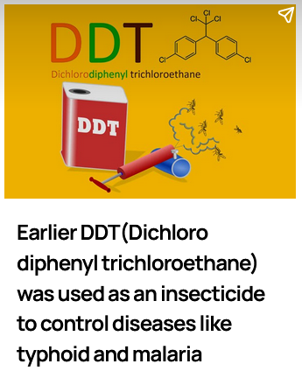
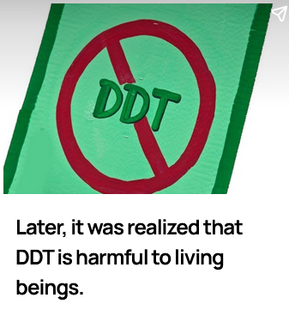
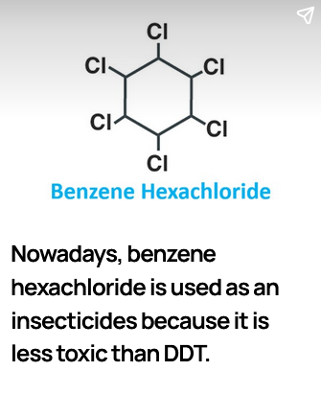
GC4. DESIGNING SAFER CHEMICALS
Chemical products should be designed to preserve efficacy of function while reducing toxicity.

Slide 52
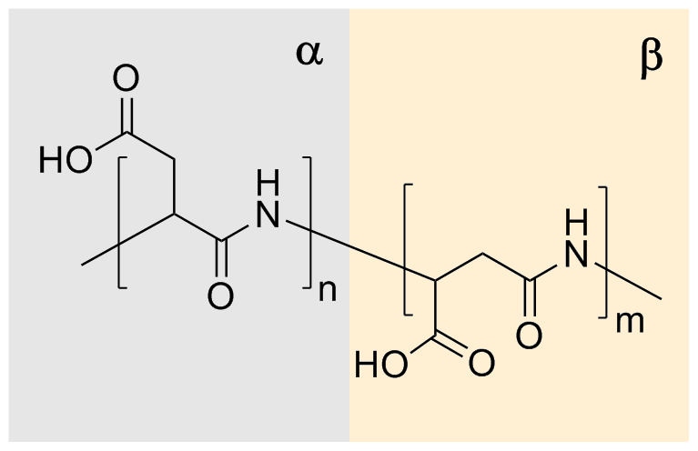
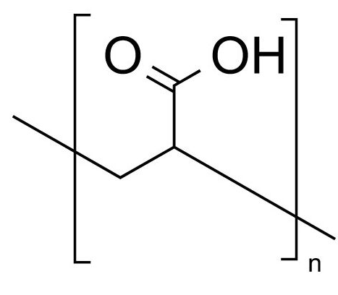
4. Designing safer chemicals
Thermal Polyaspartic acid (TPA): It is a substitute for non-biodegradable polyacrylic acid (PAC).
polyacrylic acid (PAC).
Polyaspartic acid (TPA)

Slide 53
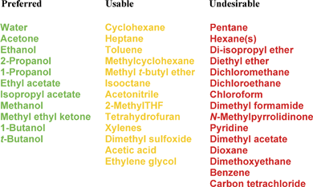

5. Safer solvents, and auxiliaries:
The use of auxiliary substances (e.g., solvents, separation agents, etc.) should be made unnecessary wherever possible and, innocuous when used.

Slide 54


5. Safer solvents, and auxiliaries:
The use of auxiliary substances (e.g., solvents, separation agents, etc.) should be made unnecessary wherever possible and, innocuous when used.

Slide 55


6. Design for energy efficiency:
Energy requirements should be recognized for their environmental and economic impacts and should be minimized. Synthetic methods should be conducted at ambient temperature and pressure

Slide 56

6. Design for energy efficiency:
Hydrazinolysis of methyl salicylate using different method
https://doi.org/10.1039/C9GC02534K

Slide 57


7. Use of renewable feedstock:
A raw material or feedstock should be renewable rather than depleting whenever technically and economically practicable.

Slide 58


7. Use of renewable feedstock:
https://doi.org/10.1016/j.fuproc.2019.106202

Slide 59

8. Reduce derivatives
Unnecessary derivatization (use of blocking groups, protection/deprotection, temporary modification of physical/chemical processes) should be minimized or avoided if possible, because such steps require additional reagents and can generate waste
This example of a selective reaction uses a protecting group, but this requires 3 steps to only make 1 change. Instead, we can eliminate the need for protecting groups by designing new and more selective reactions that are much more efficient.

Slide 60

9. Catalysis:
Catalytic reagents (as selective as possible) are superior to stoichiometric reagents

Slide 61

9. Catalysis:

Slide 62

10. Design for degradation:
Chemical products should be designed so that at the end of their function they break down into harmless degradation products and do not persist in the environment.
Polymer semiconductors
Systematically designed and characterized a series of fully degradable diketopyrrolopyrrole-based polymers with engineered sidechains to investigate the impact of several molecular design parameters on the degradation lifetimes of these polymers.
https://doi.org/10.1021/jacs.1c12845

Slide 63

11. Real-time analysis for pollution prevention:
Analytical methodologies need to be further developed to allow for real-time, in-process monitoring and control prior to the formation of hazardous substances

Slide 64


12. Inherently safer chemistry for accident prevention
Substances and the form of a substance used in a chemical process should be chosen to minimize the potential for chemical accidents, including releases, explosions, and fires.

Slide 65

E-WASTE RECYCLING
“E-waste”, “electronic waste”, “e-scrap” Are used electronics that are nearing the end of their useful life, and are discarded.
Waste printed circuit boards (PCBs)
PCBs comprise metals (Cu, Sn, Pb, Ag, Au, Pd, Fe, Ni, and Cr), nonmetals (glass fibers, electronic component insulators, capacitors, resistors, and so on), and organic compounds (epoxy resin, paints...).
Copper is the primary component of PCB, which is employed as an electric current conductor.
These discarded metals without treatment threaten the economy, the environment, and human health.
https://cen.acs.org/articles/91/web/2013/07/Circuit-Board-Waste-Mops-Toxic.html

Slide 66


Slide 67

A typical PCB comprises 40% metals, 30% plastics and 30% ceramics, with the metal fraction comprising
10–27% Cu,
2–8% Al,
1–4% Pb,
1–8% Fe,
1–6% Sn,
0.2–3.6% Ni,
0.1–1.5% Zn and
<0.1% precious metals

Slide 68

Commonly used examples of ferrous metals include steel, stainless steel, carbon steel, cast iron and wrought iron:
Steel. A combination of iron and carbon, steel is renowned for its strength and machinability. ...
Stainless Steel. ...
Carbon Steel. ...
Cast Iron. ...
Wrought Iron.
Non-ferrous metals include aluminium, copper, lead, nickel, tin, titanium and zinc, as well as copper alloys like brass and bronze.

Slide 69


Solution Concentration and Purification : After leaching, the solution is concentrated by removing the unwanted other metals (retaining the metal to be recovered in solution). By using precipitating agents, adsorbents like charcoal, activated carbon, by solvent extraction, or by electrolysis methods, the interfering metals, non metals are removed from the solution.
Metal Recovery: It is the final step in a hydrometallurgical process which involves the electrolysis, gaseous reduction, and precipitation of precious metals. Metals suitable for sale as raw materials are often directly produced in the metal recovery step.

Slide 70

HYDROMETALLURGY
E-WASTE
It involves the use of aqueous chemistry for the recovery of metals from ores, concentrates, and recycled or residual materials.
It is generally used to extract the metals such as gold, copper, silver, platinum, palladium etc.
The steps involved in this method are (1) Leaching, (2) Solution concentration and purification, and (3) Metal recovery.
Leaching: After mechanical segregation and powdering of the e-waste, The e-waste powder is dissolved in concentrated aqueous solutions of acids (HNO₃/HCl/HClO₄/H₂SO₄) and alkali to selectively dissolve and precipitate the metals. By carefully optimizing the oxidation potential, temperature, and pH of the solutions, the metals are dissolved selectively.

Slide 71

Pyrometallurgy
Pyrometallurgy is the predominantly used technology for industrial e-waste treatment. It involves smelting in furnaces at high temperatures, incineration, combustion, and pyrolysis. It is is a conventional process to recover nonferrous and precious metals from electronic waste.
In the pyrometallurgy process, the crushed scraps are liquefied in a furnace or in a molten bath to remove plastics
.
firstly, the crushed electronic waste, slagging flux, and additives (iron powder) are put into the high-temperature furnace together with air.
The refractory oxides such as plastics and glass fibers are burned and removed from the molten pool in the form of high-temperature flue gas. The heat in the furnace is ensured by exothermic reactions from the burden.
Then the impurity metal is oxidized to form the slag phase with slagging flux, at the same time, the copper and precious metals such as gold, silver, platinum, and palladium form a molten metal phase.
Finally, the metal phase and the slag phase are stratified due to the difference in immiscibility and density.
https://doi.org/10.3390/met11101500

Slide 72
Calcination: Metals are oxidized to form oxides (photographic papers)
Oxidation roasting: Metal sulfides are transformed to metal oxides.
Reactive gas refining: Metals reacts with gases forming salts. (Miller process – metal reacting with chlorine gas)
Pressurized carbonyl process: Metals react with CO forming carbonyl complex
Reduction melting: Metal chlorides react with base metal through reduction approach.
Fusion melting: melting of metals and molten salt mixture (not dissolved in aquaregia)
PbO, sodium borate, sodium carbonate and carbon

Slide 73


Battery waste management and recycling

Slide 74


Slide 75
Batteries are subjected to preheating, pyrolysis and smelting,
Firstly, the waste battery (Li or Co battery) are disassembled into separate cells and then fed into a heating furnace.
Then the electrode materials are transferred to preheating zone of the furnace, having temperature below 300 °C to ensure complete evaporation of the electrolyte without explosion.
After evaporating electrolyte, the furnace temperature is increased above 700 °C to remove the plastic of the battery.
In the smelting reduction zone, the material is smelted into alloys of Cu, Co, Ni, and Fe, along with Li, Al, Si, Ca, and some Fe slag. This method is usually only used to recover Cu, Co, Ni, and small amounts of Fe. Since Co plays an irreplaceable role in commercial LIBs, and thermal metallurgy has a high efficiency in recovering Co rather than Li.
Then to recover Li from the spent LIBs, the selective pyrolysis method of an arc furnace can be used to convert some electrode materials into Co alloys and Li concentrate Li₂CO₃, which can be separated based on difference in gravity, solubility and density. Or by hydrometallurgy.

Slide 76
Errors for Experiment # 1: Estimation of copper via iodimetric titration
Washing: clear solution of Na₂S₂O₃ should be obtained;
if turbid, repeat the preparation of standard solution
Error in weight measurements: wet hands
Incomplete transfer of Na₂S₂O₃ crystals to volumetric flask; incomplete dissolution of crystals
Incomplete addition of urea: urea crystals will be adhered to the conical flask itself. It must be directly
added to the solution itself.
Partial heating with urea; residual HNO₂ can re-oxidize iodine to iodide again.
Improper addition of base/acid: residual HNO₃ can re-oxidize Cu⁺ to Cu²⁺
Partial neutralization
Delay in titration after the KI addition - iodine escapes with time
Excess addition of titrant even after the formation of light yellow colored solution
Blue color reappears after the end point and continue the titration till the color disappears permanently
https://doi.org/10.1021/acsbiomaterials.1c00757

Slide 77
Inferences
Semiconducting Cu2I2 is formed in the iodimetric titration
Experiment is an illustration of both redox and iodimetric titration
Amount of copper is proportional to liberation of iodine
Starch indicator is added towards the end to obtain the accurate end point
Oxides of nitrogen in the solution is removed by heating with urea
KI functions only in the acidic pH range
Copper can be selectively estimated from the PCBs even in the presence of other metals
Sulfur changes its oxidation number from +2 to +2.5
Copper changes its oxidation number from +1 to +2
https://doi.org/10.1021/acsbiomaterials.1c00757

Slide 78
Societal importance
Copper waste can be transformed to semiconducting Cu₂I₂ and can be used for electrochemical studies.
Copper can be obtained via reduction of Cu₂I₂ and can be used in fabrication of simple electronic items
Experiment provides knowledge on the extraction of valuable metals from e-waste
Processing of e-waste through simple and cost-effective chemistry experiments is an promising approach
Experimental setup is useful to analyze the copper content in rusted copper alloys
https://doi.org/10.1021/acsbiomaterials.1c00757

